Slide 1

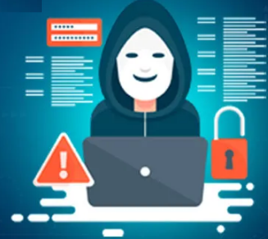
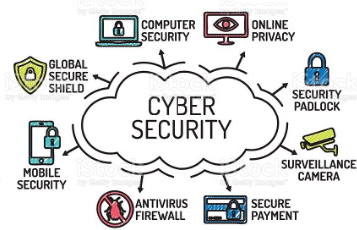
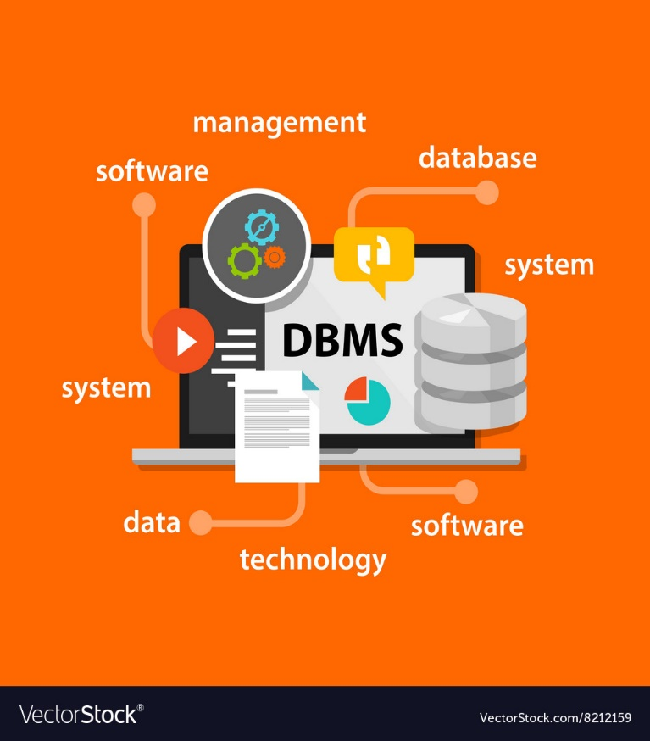

Cyber security
Unit-1
Introduction to
cyber Security
Dr.H.BALAJI
9666444100
halavathbalaji@sreenidhi.edu.in
SREENIDHI INSTITUTE OF SCIENCE & TECHNOLOGYY
YAMNAMPET, GHATKESAR 501 301, RANGA REDDY DIST.

Slide 2
Topics to be covered UNIT-I
Introduction To Cyber Security
Basic Cyber Security Concepts
Layers Of Security
Vulnerability
Threat
Harmful Acts
Motive Of Attackers,
Active Attacks
Passive Attacks
Software Attacks

Slide 3
Topics to be covered UNIT-1 Contd.
Hardware Attacks,
Spectrum Of Attacks
Taxonomy of various attacks
IP spoofing
Methods of defense
Security Models
risk management
Cyber Threats-Cyber Warfare,
Cyber Crime
Cyber terrorism
Cyber Espionage

Slide 4
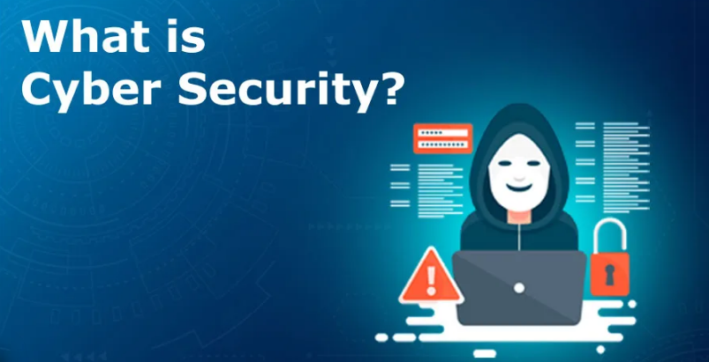


Slide 5


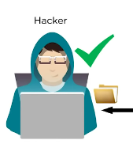
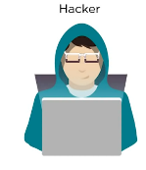

What is cyber security ?

Slide 6
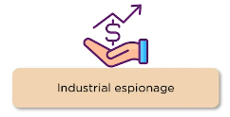
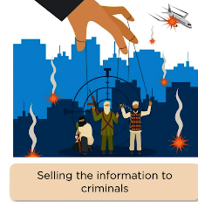
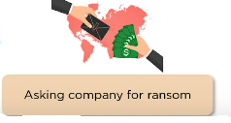
What is cyber security ?

Slide 7
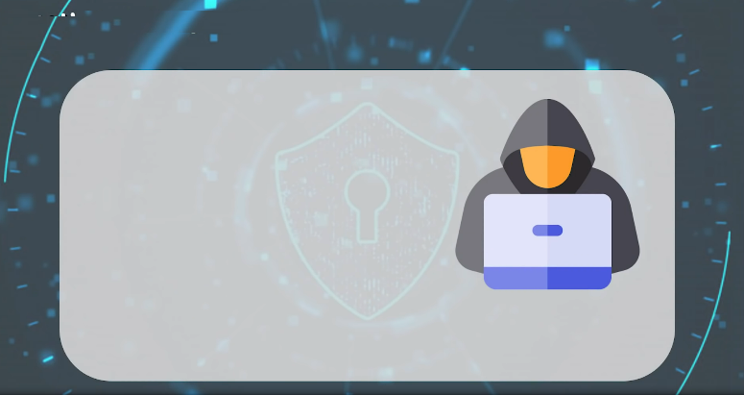
What is cyber security ?

Slide 8
Introduction to Cyber Security- Basic Cyber Security Concepts
Cyber security is the most concerned matter as cyber threats and attacks are overgrowing.
Attackers are now using more sophisticated techniques to target the systems.
Individuals, small-scale businesses or large organization, are all being impacted.
So, all these firms whether IT or non-IT firms have understood the importance of Cyber Security and focusing on adopting all possible measures to deal with cyber threats.

Slide 9
What is cyber security?
"Cyber security is primarily about people, processes, and technologies working together to encompass the full range of threat reduction, vulnerability reduction, deterrence, international engagement, incident response, resiliency, and recovery policies and activities, including computer network operations, information assurance, law enforcement, etc."

Slide 10
Other Definitions of Cyber Security
Cyber security is the body of technologies, processes, and practices designed to protect networks, computers, programs and data from attack, damage or unauthorized access.
The term cyber security refers to techniques and practices designed to protect digital data- stored, transmitted or used on an information system.
OR
Cyber security is the protection of Internet-connected systems, including hardware, software, and data from cyber attacks.
It is made up of two words one is cyber and other is security.
Cyber is related to the technology which contains systems, network and programs or data.
Whereas security related to the protection which includes systems security, network security and application and information security.

Slide 11
Why is cyber security important?
Listed below are the reasons why cyber security is so important in what’s become a predominant digital world
Cyber attacks can be extremely expensive for businesses to endure.
In addition to financial damage suffered by the business, a data breach can also inflict untold reputational damage.
Cyber-attacks these days are becoming progressively destructive. Cybercriminals are using more sophisticated ways to initiate cyber attacks.
Regulations such as GDPR(General Data Protection Regulation) are forcing organizations into taking better care of the personal data they hold.

Slide 12
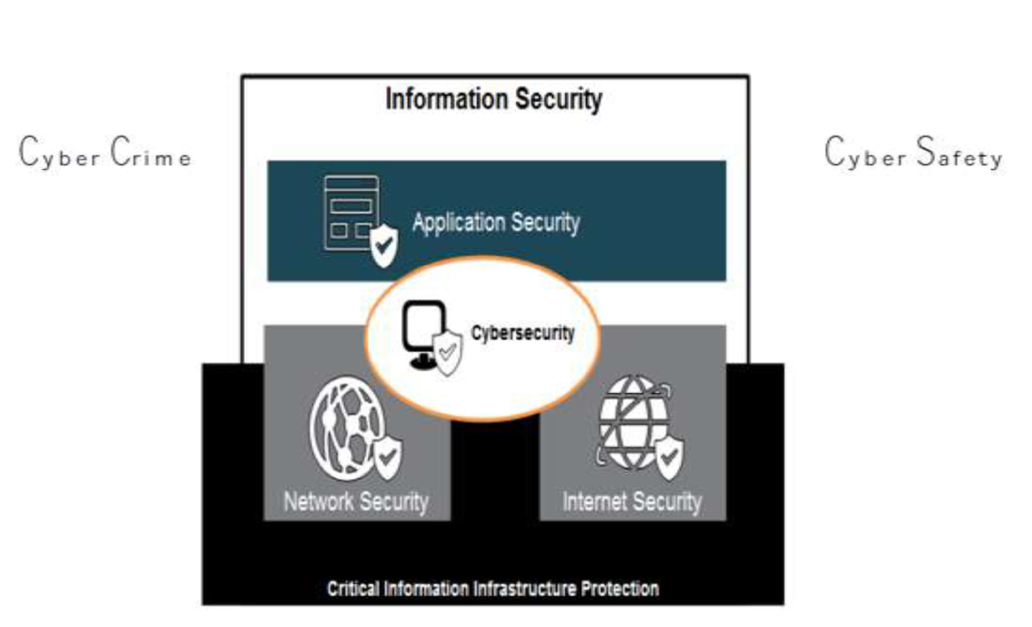
Cybersecurity and Other Security Domains

Slide 13
Other Security domains and Cybersecurity
The term applies in a variety of contexts, from business to mobile computing, and can be divided into a few common categories.
Network security is the practice of securing a computer network from intruders, whether targeted attackers or opportunistic malware.
Application security focuses on keeping software and devices free of threats. A compromised application could provide access to the data its designed to protect. Successful security begins in the design stage, well before a program or device is deployed.
Information security protects the integrity and privacy of data, both in storage and in transit.

Slide 14

Cyber security Fundamentals – Confidentiality, Integrity, Availability (CIA)
Confidentiality - preventing the disclosure of data to unauthorized parties.
Also keep the identity of authorized parties involved in sharing and holding data private and anonymous.
Often confidentiality is compromised by cracking poorly encrypted data, Man-in-the-middle (MITM) attacks, disclosing sensitive data.
Standard measures to establish confidentiality include:
Data encryption
Two-factor authentication
Biometric verification
Security tokens

Slide 15
Integrity
Integrity refers to protecting information from being modified by unauthorized parties.
Standard measures to guarantee integrity include:
Cryptographic checksums
Using file permissions
Data backups
Availability
Availability is making sure that authorized parties are able to access the information when needed.
Standard measures to guarantee availability include:
Backing up data to external drives
Implementing firewalls
Having backup power supplies
Data redundancy

Slide 16
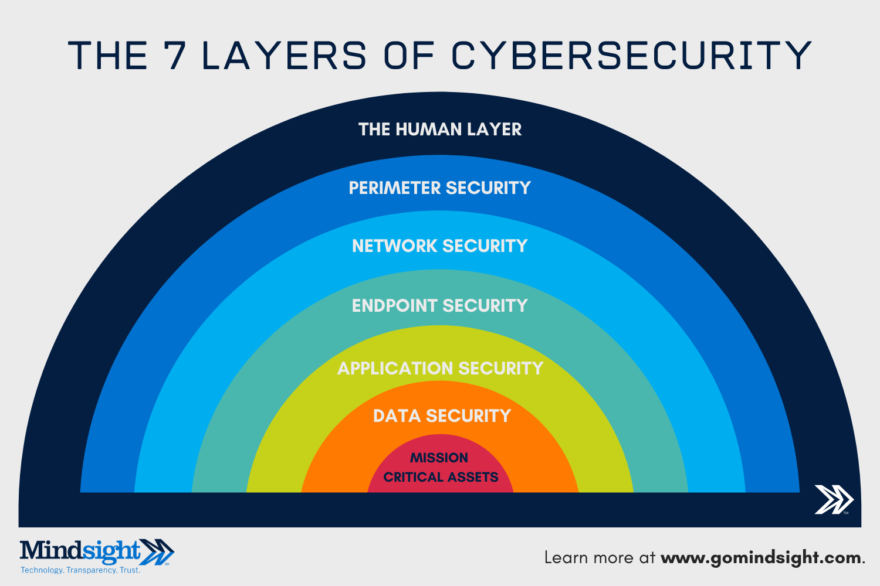

Slide 17
The 7 layers of cyber security should center on the mission critical assets you are seeking to protect.
1: Mission Critical Assets – This is the data you need to protect
2: Data Security – Data security controls protect the storage and transfer of data.
3: Application Security – Applications security controls protect access to an application, an application’s access to your mission critical assets, and the internal security of the application.
4: Endpoint Security – Endpoint security controls protect the connection between devices and the network.
5: Network Security – Network security controls protect an organization’s network and prevent unauthorized access of the network.
6: Perimeter Security – Perimeter security controls include both the physical and digital security methodologies that protect the business overall.
7: The Human Layer – Humans are the weakest link in any cyber security posture. Human security controls include phishing simulations and access management controls that protect mission critical assets from a wide variety of human threats, including cyber criminals, malicious insiders, and negligent users.

Slide 18
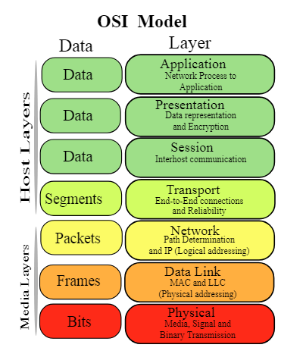
Older Model of Cyber Security (CS)
CS today goes far beyond a networking-only approach. Today, CS traverses far beyond the network realm to the endpoint, perimeter, and the humans on the other side.

Slide 19
Vulnerability, threat, Harmful acts
No system is immune to attacks –
Any company that manages, transmits, stores, or otherwise handles data has to institute and enforce mechanisms to monitor their cyber environment, identify vulnerabilities, and close up security gaps as quickly as possible.
Before identifying specific dangers to modern data systems, it is crucial to understand the distinction between cyber threats and vulnerabilities.

Slide 20
Vulnerability, threat, Harmful acts (Contd.)
Cyber threats are security incidents or circumstances with the potential to have a negative outcome for your network or other data management systems.
(Or) Possibility of a malicious attempt to damage or disrupt a computer network or system.
Examples of common types of security threats include
phishing attacks that result in the installation of malware that infects your data,
failure of a staff member to follow data protection protocols that cause a data breach, or even a
tornado that takes down your company’s data headquarters, disrupting access.

Slide 21
Vulnerabilities
Gaps or weaknesses in a system that make threats possible and tempt threat actors to exploit them.
Types of vulnerabilities in network security include (but are not limited to)
SQL injections,
server misconfigurations,
cross-site scripting, and
transmitting sensitive data in a non- encrypted plain text format.
When threat probability is multiplied by the potential loss that may result, cyber security experts refer to this as a risk.

Slide 22
SECURITY VULNERABILITIES, THREATS AND ATTACKS
Categories of vulnerabilities
• Corrupted (Loss of integrity)
• Leaky (Loss of confidentiality)
• Unavailable or very slow (Loss of availability)
Threats represent potential security harm to an asset when vulnerabilities are exploited
Attacks are threats that have been carried out
• Passive – Make use of information from the system without affecting system resources
• Active – Alter system resources or affect operation
• Insider – Initiated by an entity inside the organization
• Outsider – Initiated from outside the perimeter

Slide 23
Motive of Attackers and their actions
i) inadvertent actions (generally by insiders) that are taken without malicious or harmful intent
ii) deliberate actions (by insiders or outsiders) that are taken intentionally and are meant to do harm; and
iii) inaction (generally by insiders), such as a failure to act in a given situation, either because of a lack of appropriate skills, knowledge, guidance, or availability of the correct person to take action

Slide 24
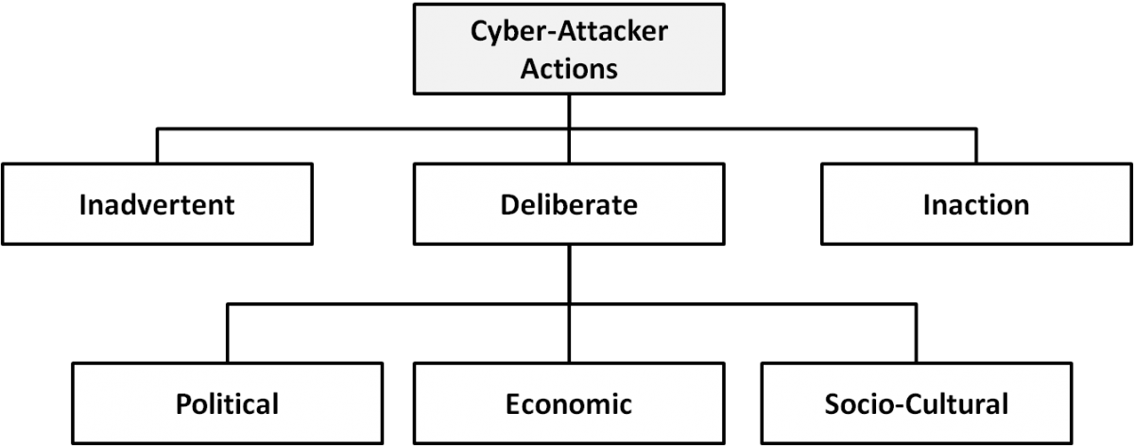
Types of cyber-attacker actions and their motivations when deliberate

Slide 25
Deliberate Attack Motivation
Political motivations: examples include destroying, disrupting, or taking control of targets; espionage; and making political statements, protests, or retaliatory actions.
Economic motivations: examples include theft of intellectual property or other economically valuable assets (e.g., funds, credit card information); fraud; industrial espionage and sabotage; and blackmail.
Socio-cultural motivations: examples include attacks with philosophical, theological, political, and even humanitarian goals (Gradido et al., 2012). Socio-cultural motivations also include fun, curiosity, and a desire for publicity or ego gratification.

Slide 26
Active attacks, passive attacks, Software attacks, hardware attacks
An active attack is a network exploit in which a hacker attempts to make changes to data on the target or data en route to the target.
Types of Active attacks:
Masquerade: in this attack, the intruder pretends to be a particular user of a system to gain access or to gain greater privileges than they are authorized for. A masquerade may be attempted through the use of stolen login IDs and passwords, through finding security gaps in programs or through bypassing the authentication mechanism.
Session replay: In this type of attack, a hacker steals an authorized user’s log in information by stealing the session ID. The intruder gains access and the ability to do anything the authorized user can do on the website.
Message modification: In this attack, an intruder alters packet header addresses to direct a message to a different destination or modify the data on a target machine.
In a denial of service (DoS) attack, users are deprived of access to a network or web resource. This is generally accomplished by overwhelming the target with more traffic than it can handle.
In a distributed denial-of-service (DDoS) exploit, large numbers of compromised systems (sometimes called a botnet or zombie army) attack a single target.

Slide 27
Active attacks, Passive attacks, Software attacks, hardware attacks
Passive attacks are relatively scarce from a classification perspective, but can be carried out with relative ease, particularly if the traffic is not encrypted.
Types of Active attacks:
Eavesdropping (tapping): the attacker simply listens to messages exchanged by two entities. For the attack to be useful, the traffic must not be encrypted. Any unencrypted information, such as a password sent in response to an HTTP request, may be retrieved by the attacker.
Traffic analysis: the attacker looks at the metadata transmitted in traffic in order to deduce information relating to the exchange and the participating entities, e.g. the form of the exchanged traffic (rate, duration, etc.). In the cases where encrypted data are used, traffic analysis can also lead to attacks by cryptanalysis, whereby the attacker may obtain information or succeed in unencrypting the traffic.

Slide 28
Active attacks, Passive attacks, Software attacks, hardware attacks
Malicious code (sometimes called malware) is a type of software designed to take over or damage a computer user's operating system, without the user's knowledge or approval.
It can be very difficult to remove and very damaging.
Common malware examples are
Virus
Worm
Trojan horse
Logic Bomb

Slide 29
Virus A virus is a program that attempts to damage a computer system and replicate itself to other computer systems. A virus:
• Requires a host to replicate and usually attaches itself to a host file or a hard drive sector.
• Replicates each time the host is used.
• Often focuses on destruction or corruption of data.
• Usually attaches to files with execution capabilities such as .doc, .exe, and .bat extensions.
• Often distributes via e-mail. Many viruses can e-mail themselves to everyone in your address book.
• Examples: Stoned, Michelangelo, Melissa, I Love You.
Worm A worm is a self-replicating program that can be designed to do any number of things, such as delete files or send documents via e-mail. A worm can negatively impact network traffic just in the process of replicating itself. A worm:
• Can install a backdoor in the infected computer.
• Is usually introduced into the system through a vulnerability.
• Infects one system and spreads to other systems on the network.
• Example: Code Red.

Slide 30
Trojan horse A Trojan horse is a malicious program that is disguised as legitimate software. Discretionary environments are often more vulnerable and susceptible to Trojan horse attacks because security is user focused and user directed. Thus the compromise of a user account could lead to the compromise of the entire environment. A Trojan horse:
• Cannot replicate itself.
• Often contains spying functions (such as a packet sniffer) or backdoor functions that allow a computer to be remotely controlled from the network.
• Often is hidden in useful software such as screen savers or games.
• Example: Back Orifice, Net Bus, Whack-a-Mole.
Logic Bomb A Logic Bomb is malware that lies dormant until triggered. A logic bomb is a specific example of an asynchronous attack.
• A trigger activity may be a specific date and time, the launching of a specific program, or the processing of a specific type of activity.
• Logic bombs do not self-replicate.

Slide 31
Active attacks, Passive attacks, Software attacks, Hardware attacks
Common hardware attacks include:
• Manufacturing backdoors, for malware or other penetrative purposes; backdoors aren’t limited to software and hardware, but they also affect embedded radio- frequency identification (RFID) chips and memory
• Eavesdropping by gaining access to protected memory without opening other hardware
• Inducing faults, causing the interruption of normal behavior
• Hardware modification tampering with invasive operations
• Backdoor creation; the presence of hidden methods for bypassing normal computer authentication systems
• Counterfeiting product assets that can produce extraordinary operations and those made to gain malicious access to systems.

Slide 32
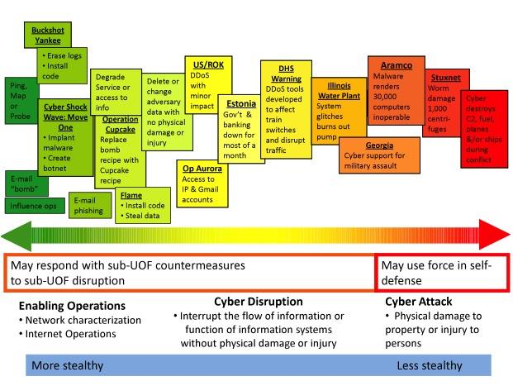
Spectrum of Cyber Attacks

Slide 33
Taxonomy of various attacks

Slide 34
Cyber Threats-Cyber Warfare, Cyber Crime, Cyber terrorism, Cyber Espionage
Cyber Threats-Cyber Warfare: Cyber warfare refers to the use of digital attacks -- like computer viruses and hacking -- by one country to disrupt the vital computer systems of another, with the aim of creating damage, death and destruction. Future wars will see hackers using computer code to attack an enemy's infrastructure, fighting alongside troops using conventional weapons like guns and missiles.
Cyber warfare involves the actions by a nation-state or international organization to attack and attempt to damage another nation's computers or information networks through, for example, computer viruses or denial-of-service attacks.
Cyber Crime:
Cybercrime is criminal activity that either targets or uses a computer, a computer network or a networked device.Cybercrime is committed by cybercriminals or hackers who want to make money. Cybercrime is carried out by individuals or organizations.
Some cybercriminals are organized, use advanced techniques and are highly technically skilled. Others are novice hackers.

Slide 35
Cyber Threats-Cyber Warfare, Cyber Crime, Cyber terrorism, Cyber Espionage (contd.)
Cyber Terrorism:
Cyber terrorism is the convergence of cyberspace and terrorism. It refers to unlawful attacks and threats of attacks against computers, networks and the information stored therein when done to intimidate or coerce a government or its people in furtherance of political or social objectives.
Examples are hacking into computer systems, introducing viruses to vulnerable networks, web site defacing, Denial-of-service attacks, or terroristic threats made via electronic communication.
Cyber Espionage:
Cyber spying, or cyber espionage, is the act or practice of obtaining secrets and information without the permission and knowledge of the holder of the information from
individuals, competitors, rivals, groups, governments and enemies for personal, economic, political or military advantage using methods on the Internet.

